Slide 1
BGL17: A Better Graph Library in C++17
Andrew Lumsdaine (PNNL / UW)
Kevin DeWeese (UW)
Jesun Firoz (PNNL)
Marcin Zalewski (Nvidia)
Scott McMillan (CMU / SEI)

Slide 2
D1709R2: Graph Library (C++23?)
Project: | ISO JTC1/SC22/WG21: Programming Language C++
Audience: | SG19, WG21
Authors: | Phillip Ratzloff (SAS Institute) Richard Dosselmann (U of Regina) Michael Wong (Codeplay) Matthew Galati (SAS Institute) Andrew Lumsdaine (PNW National Laboratory) Jens Maurer Domagoj Saric

Slide 3
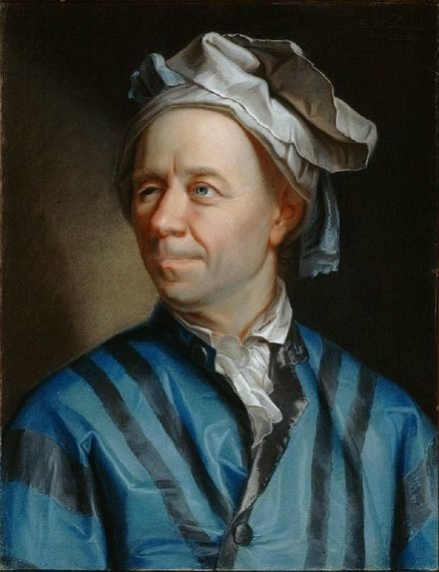
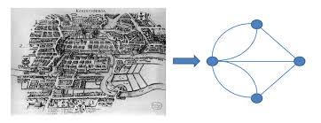
Graphs

Slide 4
Boost Graph breadth_first_search (one version)

Slide 5
Graphs

Slide 6
BGL17

Slide 7
There are no graphs

Slide 8
No graphs
Algorithms take range of ranges
Iterators, begin(), end()
Customary C++ Standard Library
Adapters specify how graph is traversed
Using iterators
“Graph” algorithms composed from traversals etc
Notes:
A graph is a collection of objects and relationships between objects
Represent a graph generically as a range of ranges
Has begin, end, iterators, etc
STL algorithms work on ranges
Use adaptors to specify how a graph is “walked”
Use iterators to walk the graph
Use range based for, or STL for_each (etc) to implement algorithms based on walking

Slide 9

Generic triangle counting

Slide 10
Parallel generic triangle counting

Slide 11

Parallel generic triangle counting (shared memory)
Parallelize on outer loop
Almost same code as before
(Could parameterize to reuse)

Slide 12

Usage
Compress on index 0
Compress on index 1
Notes:
A graph is a collection of objects and relationships between objects
Represent a graph generically as a range of ranges
Has begin, end, iterators, etc
STL algorithms work on ranges
Use adaptors to specify how a graph is “walked”
Use iterators to walk the graph
Use range based for, or STL for_each (etc) to implement algorithms based on walking

Slide 13
Generic triangle counting
Range of ranges
What makes this a graph!

Slide 14
Concept interface (C++20) (?)
A graph is a container of containers
That stores something that can index into itself

Slide 15
Requirements (for triangle counting)
Inner containers need to be WeaklyMergeable (elements are ordered in same way with same strict weak ordering)
The elements in the inner containers need to all be successors or predecessors of their corresponding index

Slide 16
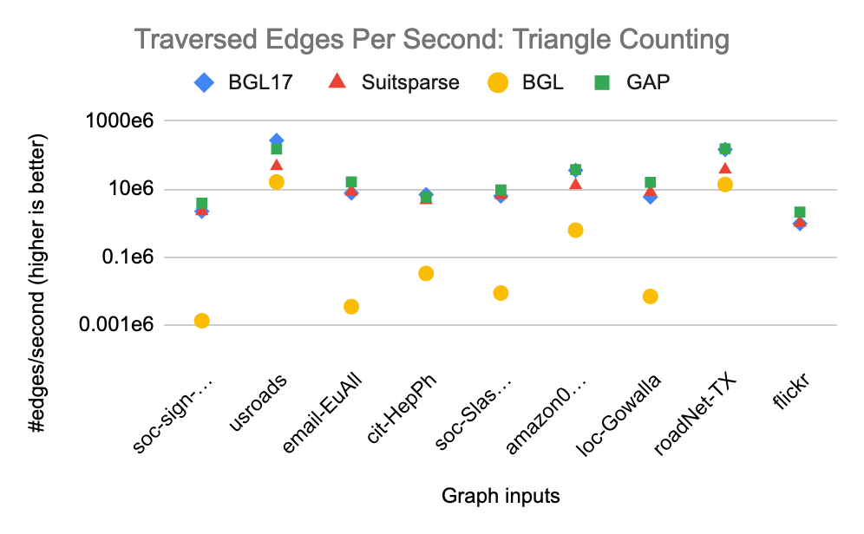

Triangle Counting Performance Results

Slide 17
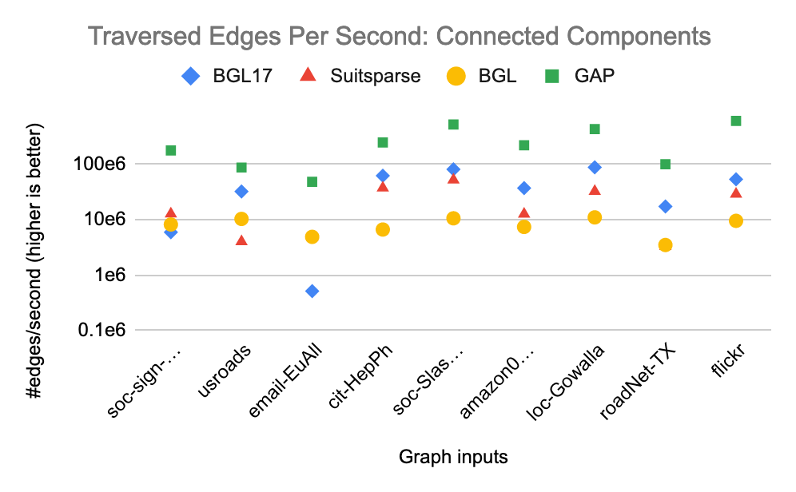
Connected Components Performance Results

Slide 18
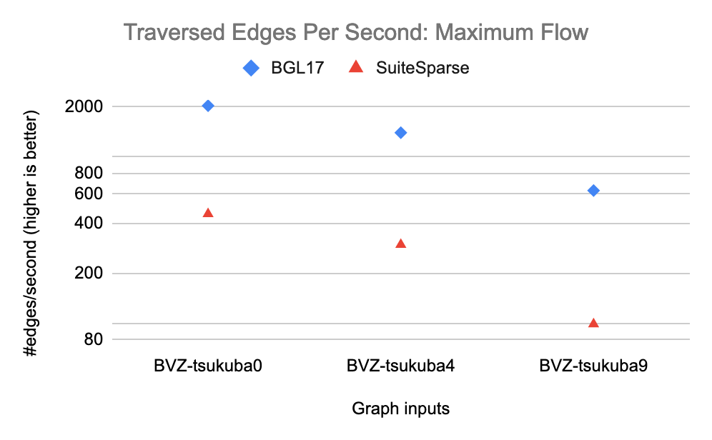

Max Flow Performance Results

Slide 19
Speedup

Slide 20
Algorithm Availability
Unavailable (we think) | Available | Verified (by us) | Verified (by others)
 | BFS | Triangle Count | K-Truss | Bellman Ford | BC | CC | SCC | MSF | Dijkstra | Maxflow | Pagerank | Δ-Stepping
BGL17
BGL
SuiteSparse LA Graph
GAPBS
Galois
Notes:
◔○◑●

Slide 21
Thank you!

Slide 22




Creative Commons BY-NC-SA 4.0 License
© Andrew Lumsdaine, 2017-2018
Except where otherwise noted, this work is licensed under
https://creativecommons.org/licenses/by-nc-sa/4.0/

